Slide 1
Shapes Editor/Paint using OOPs
Group Members:
Abhishek Dharmadhikari(111903007)
Abhay Gaikwad(111903003)
Abhishek Gaikwad(111903006)

Slide 2
Objectives:
The drawing will have tools like rectangle, square, circle, ellipse, triangle, polygons of any shape (upto 20 edges as it converges to circle only after 20 edges)
Defining certain operations on shapes like colouring border, filling area ,different options for increasing Pixel size.
Airbrush feature with different sizes.
Radial Brush Feature for symmetric shapes.
2

Slide 3
Project structure and functionalities:
Creating class of Polygon, lines , point as individual base classes
A component inherits a basic class, which has properties as position, size, color as well as methods to display it on the screen, hide, move, resize.
Event handling:
Event handlers of mouse and keyboard calling the appropriate methods of the class.
Eg . q ,escape key for quit, ‘+’ ,’ – ‘ for manipulation of size of shape.
3

Slide 4
Action Plan:
Writing code for base class of polygon, line, point and derived classes like rectangle , circle, ellipse and building hierarchical inheritance among all classes.
1
Implementing different methods for shapes and ability to change properties of shapes using GUI( OpenGL used.)
2
Writing code for event handling such as classes will handle events from mouse and keyboard using methods defined for class.
Interfacing with GLUT for event handling.
3
4

Slide 5
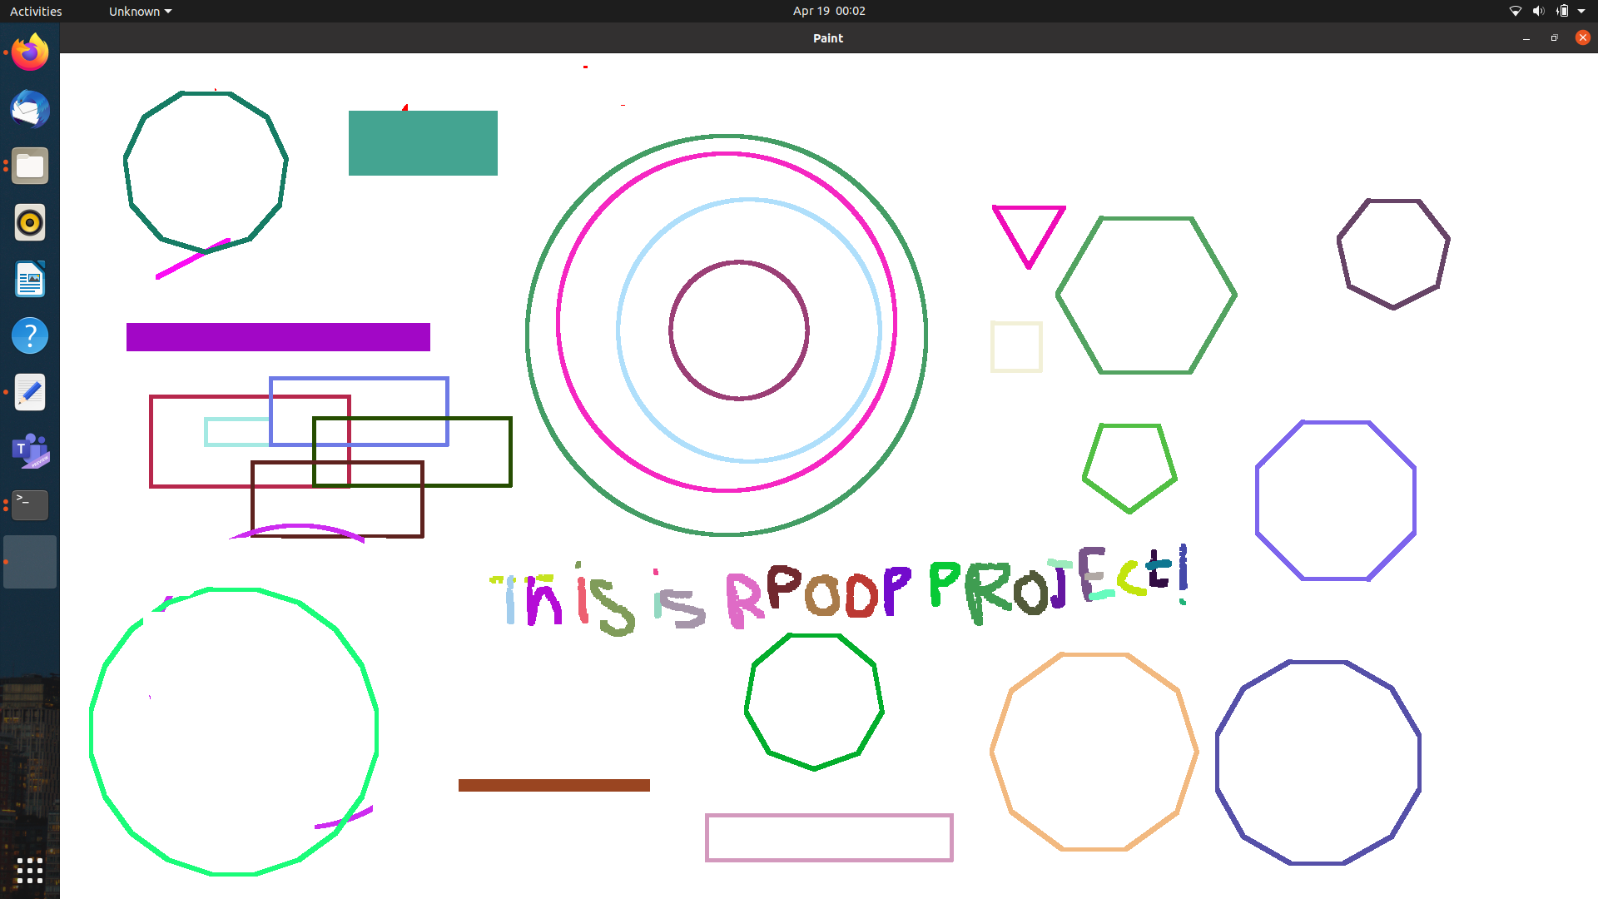
5

Slide 6
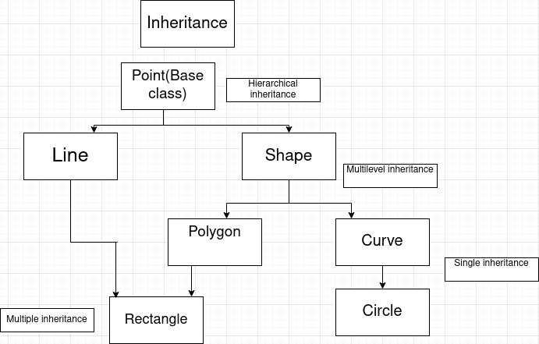
Inheritance Used in Project:
6

Slide 7
Thank you
7

